Slide 1

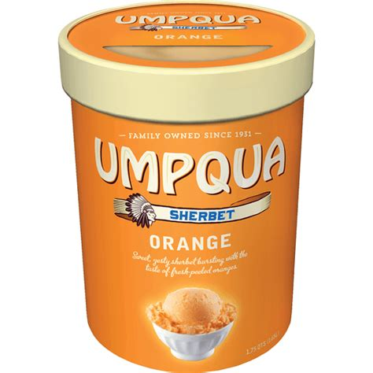
LIFE EXPECTANCY ANALYSIS
How is life expectancy in a OECD country affected by Alcohol Consumption, GDP, Population, Vaccination DTP, Vaccination Measles and, Health Spending?
By:
Maria Ibarra Prado
Reginald Robinson
Lisa Huynh

Slide 2
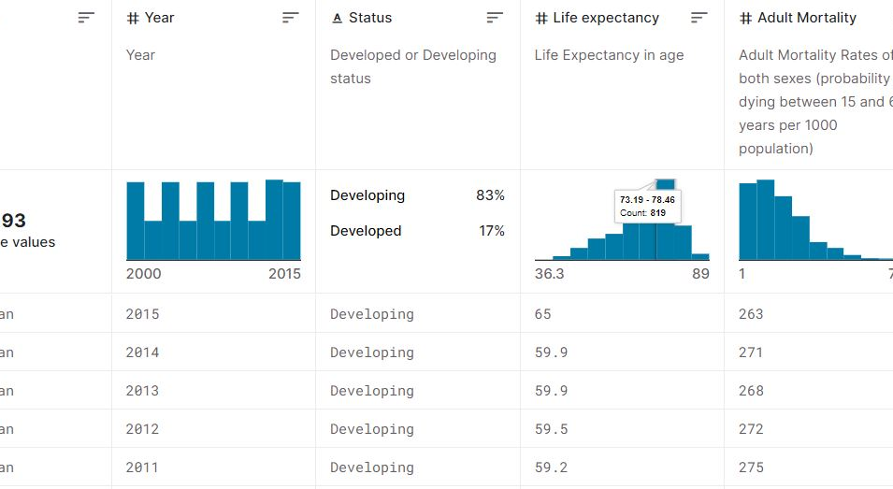
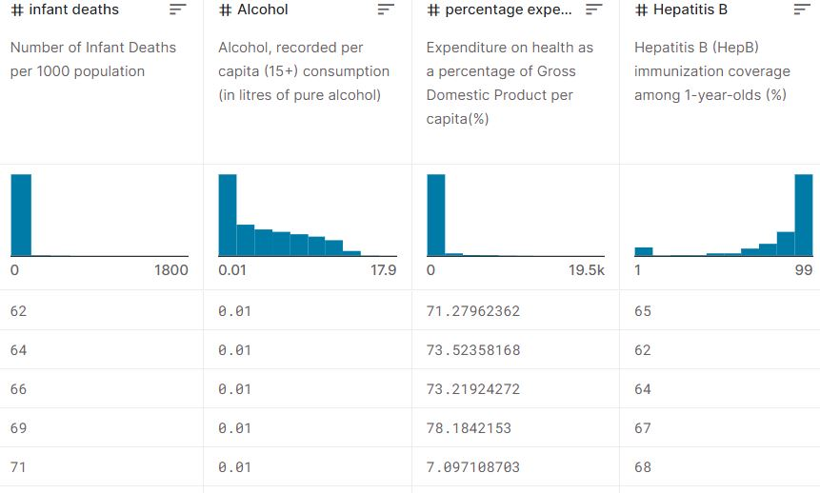
The data set
We combined data from the Organization for Economic Co-operation and Development (OECD) for our analysis
Data used:
Life Expectancy at birth,
Alcohol Consumption,
GDP per Capita,
Population,
Youth Vaccination,
Health Spending

Slide 3
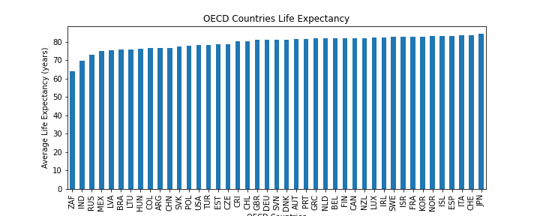
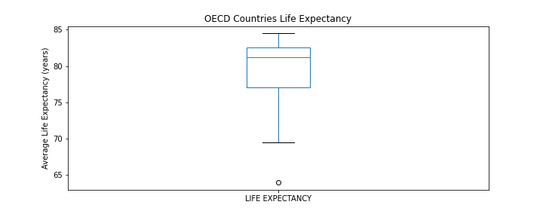
What is the median life expectancy for the population of the OECD countries?
81.23 years is the median life expectancy at birth
The lower quartile is: 77.1
The upper quartile is: 82.5
The interquartile range is: 5.4

Slide 4
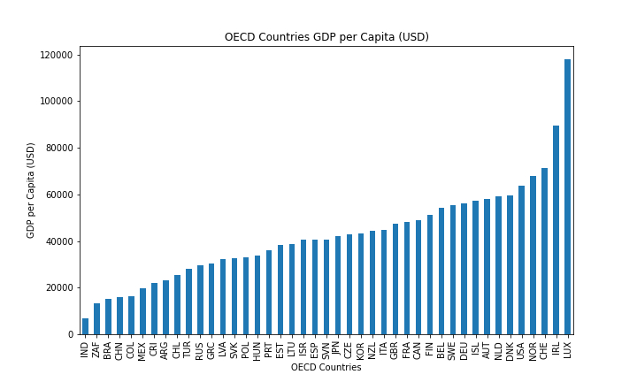
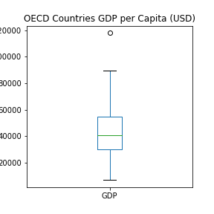
What is the median GDP per Capita of the OECD countries?
40.6K is the median GDP per Capita
The lower quartile is: 29.9K
The upper quartile is: 54.7K
The interquartile range is: 24.9K

Slide 5

Findings

Slide 6
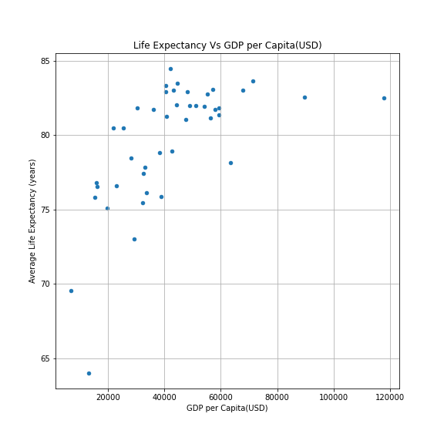
Do countries with higher GDPs per capita have higher life expectancies?
GDP per capita and Life expectancy are positively linked
61% is the correlation between GDP per Capita and Life Expectancy
Mean of GDP for countries with life expectancy below 81: 27.9K
Mean of GDP for countries with life expectancy over 81: 54. 4 K
T-test Result (statistic=-5.4976, pvalue=0.00000231)

Slide 7
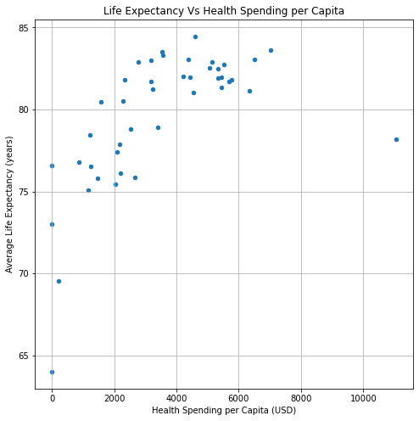
Should a country increase its healthcare spending to improve average lifespan?
More spending on healthcare has a net positive affect
62% correlation between Healthcare spending per Capita and Life Expectancy
Median annual spending per capita is: 3.2 K
Mean of healthcare spending per capita for countries with life expectancy below 81: 2K
Mean of healthcare spending per capita for countries with life expectancy over 81: 4.69K
T-test Result (statistic=-4.4269, pvalue=0.000157)

Slide 8
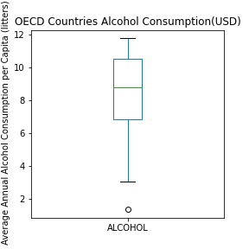
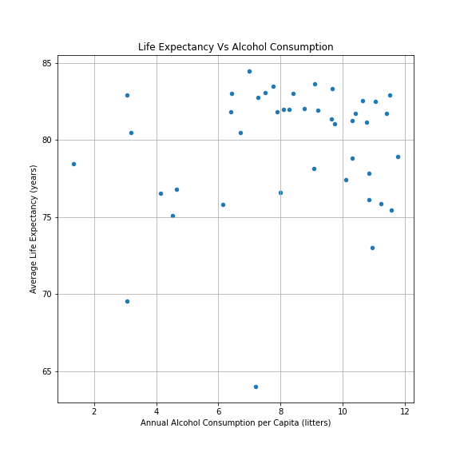
Does Life Expectancy have a positive or negative relationship with drinking alcohol?
15% correlation between Alcohol consumption per capita and Life Expectancy

Slide 9
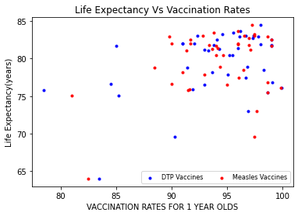
What is the impact of Immunization coverage on Life Expectancy?
Immunization and LE- Correlation: DTP 42%, Measles 34%

Slide 10
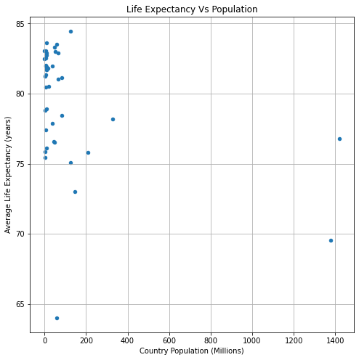
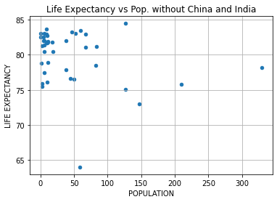
Do populous countries tend to have lower life expectancies??
Population and LE- Correlation: -39%

Slide 11
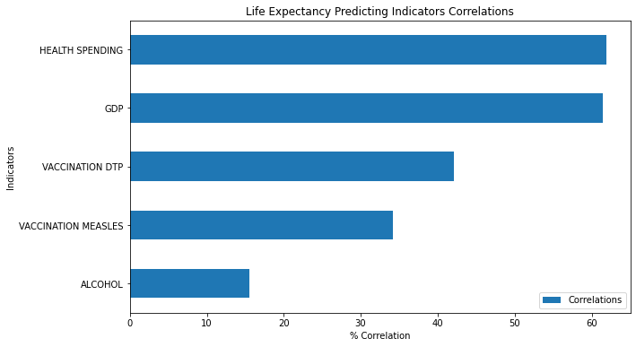
Overall, Health Spending & GDP per Capita are strongest indicators to determine Life Expectancy

Slide 12
Thank you!

